Slide 1
Object-Oriented Systems Development:
Using the Unified Modeling Language
Chapter 11:
Access Layer: Object Storage and Object Interoperability

Slide 2

Goals
Object storage and persistence.
Database management systems and their technology.
Client-server computing.
Distributed databases.
Distributed object computing.

Slide 3
Goals (Con’t)
Object-oriented database management systems.
Object-relational systems.
Designing access layer objects.

Slide 4
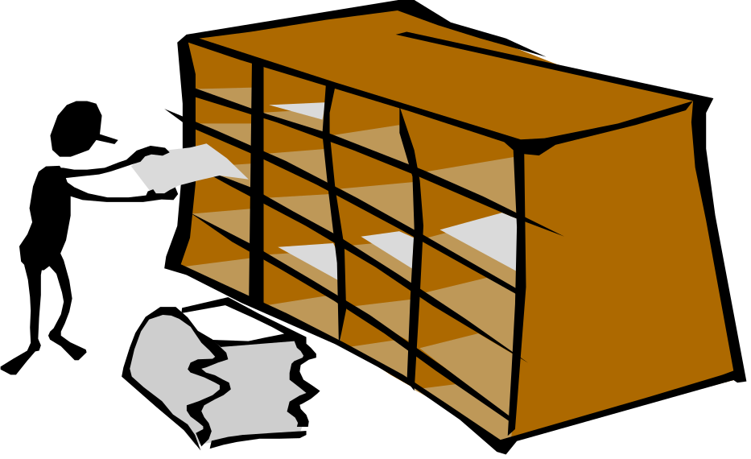
Introduction
A database management system (DBMS) is a collection of related data and associated programs that access, manipulate, protect and manage data.

Slide 5

What’s the purpose of DBMS
The main purpose of a DBMS is to provide a reliable, persistent data storage facility,
and mechanism for efficient and convenient data access and retrieval.

Slide 6
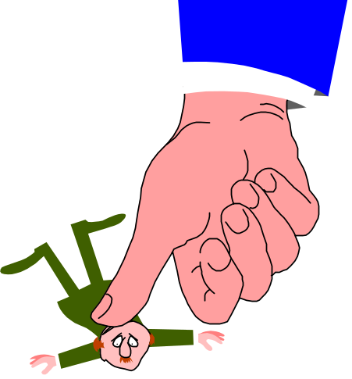
Persistence (review)
Persistence is defined as objects that outlive the programs which created them.
Persistent object stores do not support query or interactive user interface facilities, as found in a fully supported DBMS or OODBMS.

Slide 7
Object Storage and Persistence
Atkinson et al. describe six broad categories for the lifetime of data:
  1. Transient results to the evaluation of expressions.
  2. Variables involved in procedure activation (parameters and variables with a localized scope).
  3. Global variables and variables that are dynamically allocated.
Notes:
The first three categories are transient data, data that cease to exist beyond the lifetime of the creating process. The other three are nontransient, or persistent, data.

Slide 8
Object Storage and Persistence (Con’t)
  4. Data that exist between the executions of a program.
  5. Data that exist between the versions of a program.
  6. Data that outlive a program.

Slide 9
Database Management Systems
A DBMS is a set of programs that enable the creation and maintenance of a collection of related data.
DBMS have a number of properties that distinguish them from the file-based data management approach.

Slide 10
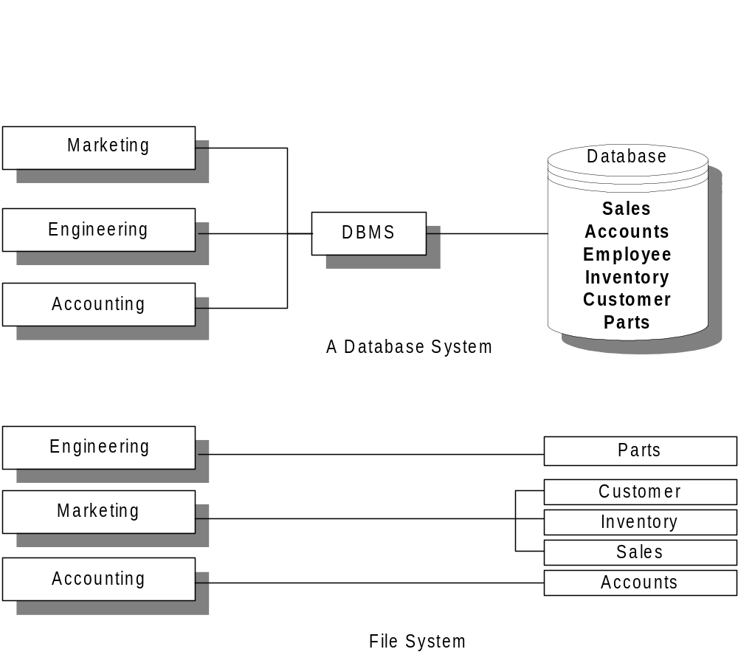
Database system Vs. File System.

Slide 11
Database Models
A database model is a collection of logical constructs used to represent the data structure and data relationships within the database.
Hierarchical Model
  Network Model
  Relational Model

Slide 12
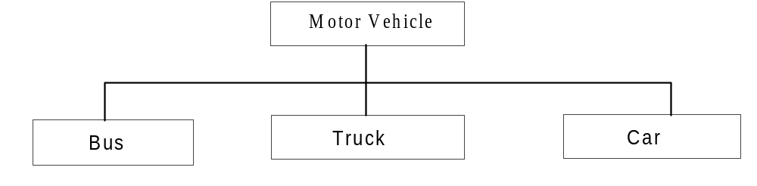
Hierarchical model
The hierarchical model represents data as a single-rooted tree.
Notes:
The top layer the root is perceived as the parent of the segment directly bellow it. In this Case Motor vehicle is the parent of the Bus, Truck and Car. A segment also is called node. The segment below other node is the children of the node above it. Bus, truck and car are children of Motor Vehicle.

Slide 13
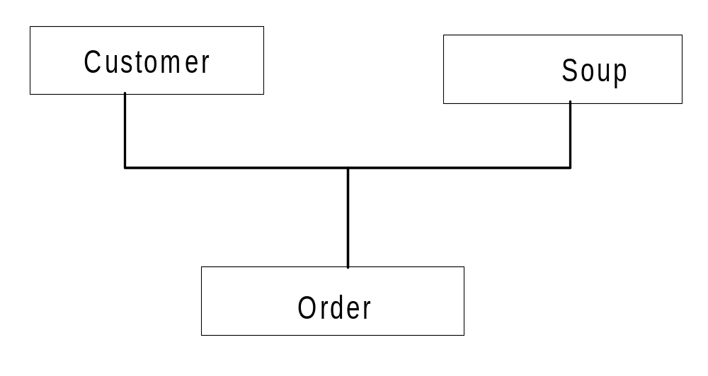
Network model
A network database model is similar to a hierarchical database, with one distinction.
Unlike the hierarchical model, a network model's record can have more than one parent.
Notes:
An order contain data form both Customer and Soup.

Slide 14
Relational Model
Of all the database models, the relational model has the simplest, most uniform structure and is the most commercially widespread.

Slide 15
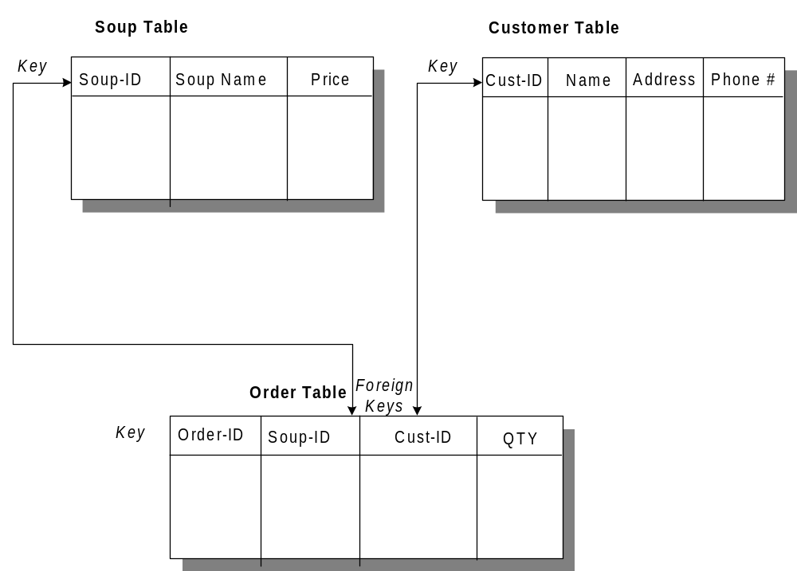
Relational Database (Con’t)
Notes:
Soup-ID is the primary key of the Soup Table, Cust-ID is the primary key of the Customer table and Order ID is the primary key of the Order table. Soup-ID and Cust-ID are foreign keys in the Order table.

Slide 16
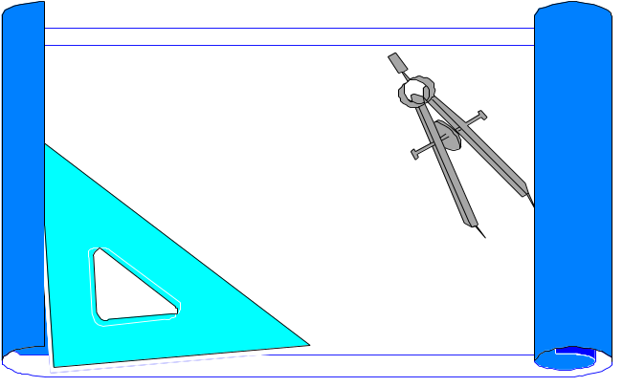
What is a schema and metadata?
The schema, or metadata, contains a complete definition of the data formats, such as the data structures, types, and constraints.

Slide 17
Schema (Con’t)
In an object-oriented DBMS, the schema is the collection of class definitions.
The relationships among classes (such as super/sub) are maintained as part of the schema.

Slide 18
Database Definition Language (DDL)
A database definition language (DDL) is used to describe the structure of and relationships between objects stored in a database.

Slide 19
Data Manipulation Language (DML)
Once data is stored in a database, there must be a way to get it, use it, and manipulate it.
DML is a language that allows users to access and manipulate (such as: creation, saving and destruction of) data organization.

Slide 20
DML (Con’t)
The Structured Query Language (SQL) is the standard DML for relational DBMS.
In a relational DBMS, the DML is independent from a host programming language.

Slide 21
DML (Con’t)
For example, a host language such as C or COBOL would be used to write the body of the application.
SQL statements are then typically embedded in C or COBOL applications to manipulate data.

Slide 22
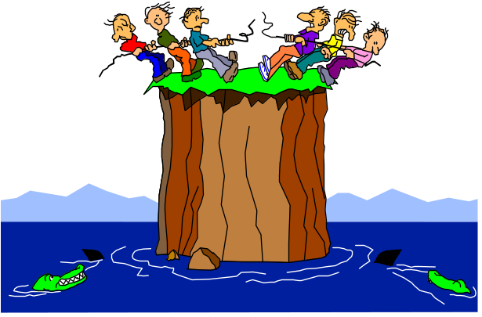
Shareability
Data in the database often needs to be accessed and shared by different applications.
The database then must detect and mediate the conflicts and promote the greatest amount of sharing possible without sacrificing the integrity of data.

Slide 23

Transaction
A transaction is a unit of change, in which either all changes to objects within a transaction will be applied or not at all.
A transaction is said to commit if all changes can be successfully made to the database and to abort if all changes cannot be successfully made to the database.

Slide 24

Concurrency Control
Programs will attempt to read and write the same pieces of information simultaneously and, in doing so, create a contention for data.
The concurrency control mechanism is
thus established to
mediate these conflicts.

Slide 25

Concurrency Control (Con’t)
It does so by making policies that dictate how read and write conflicts will be handled.

Slide 26

Concurrency Control (Con’t)
The most conservative way is to allow a user to lock all records or objects when they are accessed and to release the locks only after a transaction commits.

Slide 27

Concurrency Control (Con’t)
By distinguishing between reading the data, and writing it (which is achieved by qualifying the type of lock placed in the data-read lock or write lock) somewhat greater concurrency can be achieved.
This policy allows many readers of a record or an objective, but only one writer.

Slide 28
Distributed Databases
In distributed databases portions of the database reside on different nodes (computers) in the network.

Slide 29
Client/Server Computing
Client/server computing allows objects to be executed in different memory spaces or even different machines.

Slide 30
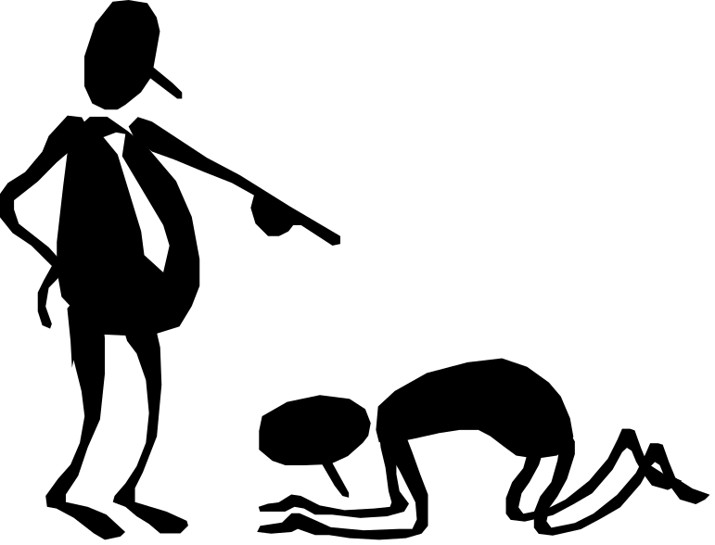
Client/Server Computing (Con’t)
The calling module becomes the "client" (which requests a service), and the called module becomes the "server" (which provides the service).

Slide 31
Client/Server Computing (Con’t)
Client programs usually manage:
The user-interface
Validate data entered by the user
Dispatch requests to server programs, and sometimes
Execute business logic.

Slide 32
Client/Server Computing (Con’t)
The Business layer contains all of the objects that represent the business such as:
  Order
  Customer
  Line Item
  Inventory, etc.

Slide 33

Client/Server Computing (Con’t)
A server process (program) fulfills the client request by performing the task requested.
Server programs generally receive requests from client programs, execute database retrieval and updates, manage data integrity, and dispatch responses to client requests.

Slide 34
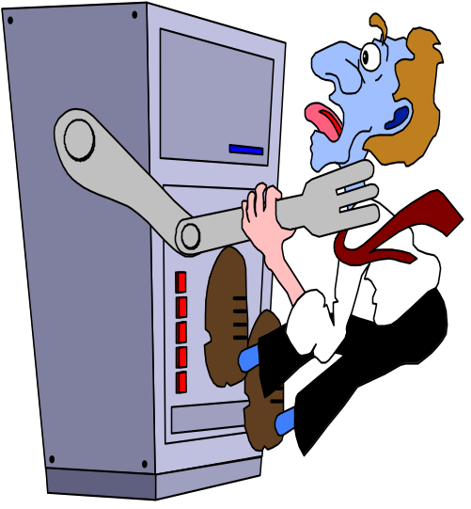
A Two-Tier Architecture
A two-tier architecture is one where a client talks directly to a server, with no intervening server.
This type of architecture is typically used in small environments with less than 50 users.

Slide 35
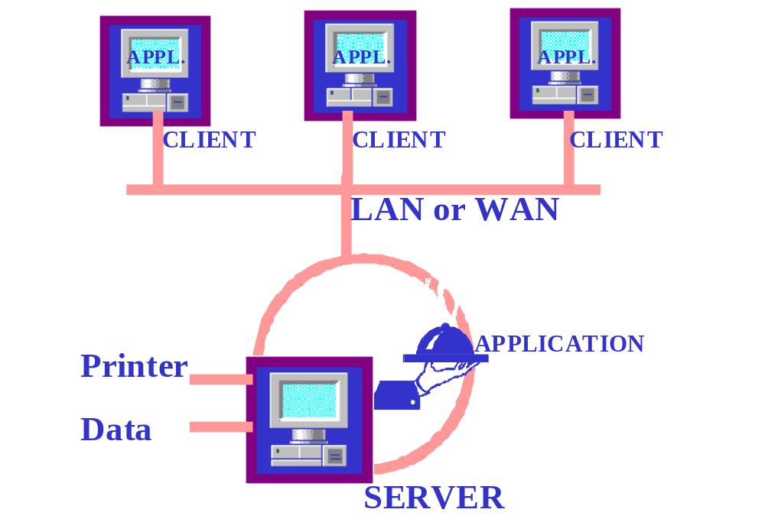
A Two-Tier Architecture (Con’t)

Slide 36
A Three-Tier Architecture
A three-tier architecture introduces another server (or an "agent") between the client and the server.
The role of the agent is many fold.
It can provide translation services as in adapting a legacy application on a mainframe to a client/server environment.

Slide 37
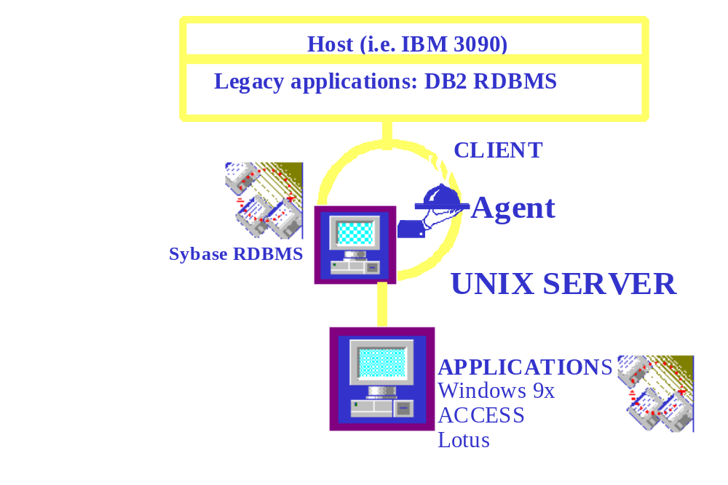
A Three-Tier Architecture (Con’t)

Slide 38

Basic Characteristics of Client/Server Architectures
1. The client or front-end interacts with the user, and a server or back-end interacts with the shared resource.

Slide 39
Basic Characteristics of Client/Server Architectures (Con’t)
2. The front-end task and back-end task have fundamentally different requirements for computing resources.
Resources such as processor speeds, memory, disk speeds and capacities, and input/output devices.

Slide 40
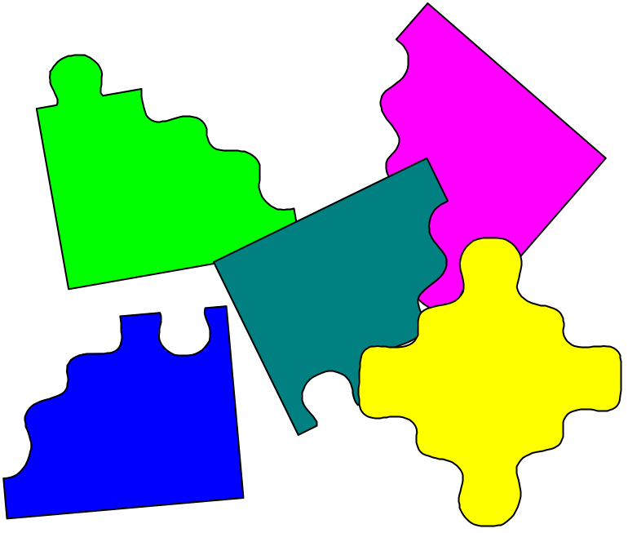
Basic Characteristics of Client/Server Architectures (Con’t)
3. The environment is typically heterogeneous and multi-vendor.

Slide 41
Basic Characteristics of Client/Server Architectures (Con’t)
4. Client-server systems can be scaled horizontally or vertically.
Horizontal scaling means adding or removing client workstations with only a slight performance impact.
Vertical scaling means migrating to a larger and faster server machine or multi servers.

Slide 42
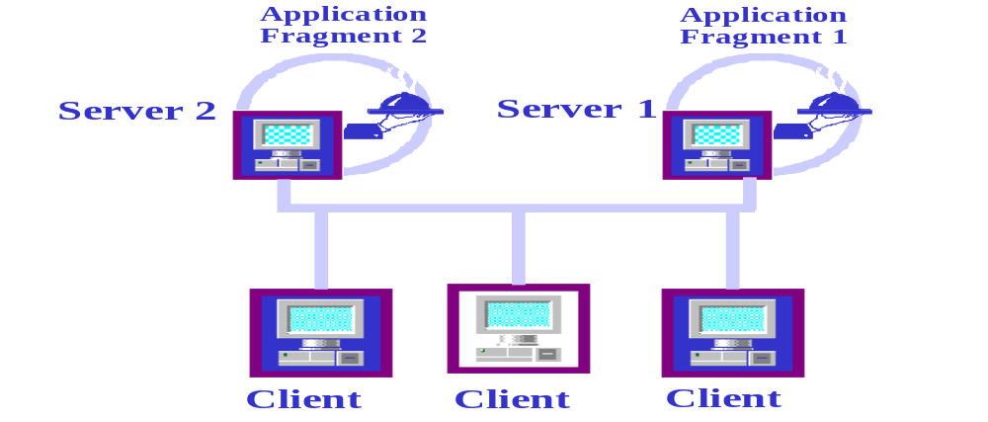
Distributed Processing
Distributed processing implies that processing will occur on more than one processor in order for a transaction to be completed.

Slide 43
Distributed Processing (Con’t)
For example, in processing an order from our client, the client information may process at one machine and the account information will then be processed next on a different machine.

Slide 44
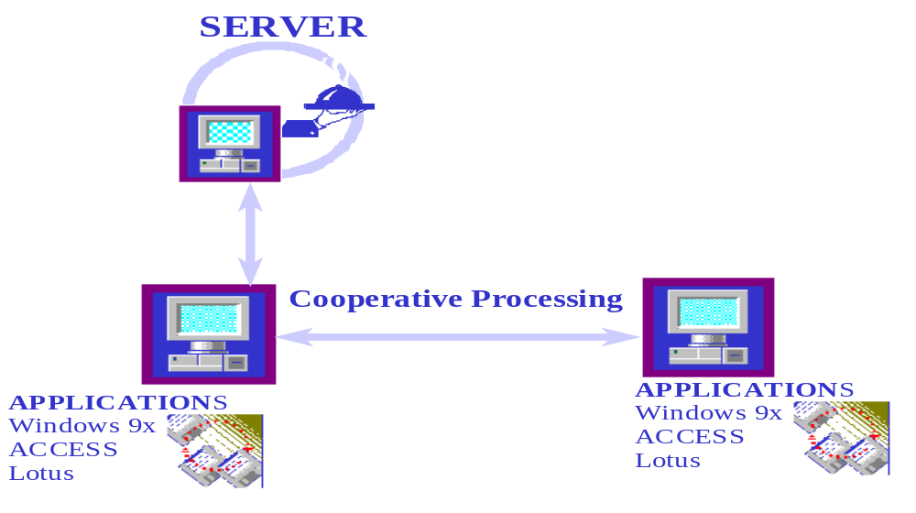
Cooperative processing
Cooperative processing is a form of distributed computing where two or more distinct processes are required to complete a single business transaction.

Slide 45
Client/Server Components
I. User Interface Layer: This is one of the major components of the client/server application.
It interacts with users, screens, Windows, Window management, keyboard, and mouse handling.

Slide 46
Client/Server Components (Con’t)
II. Business Processing Layer: This is a part of the application that uses the user interface data to perform business tasks.

Slide 47
Client/Server Components (Con’t)
III. Database Processing Layer: This is a part of the application code that manipulates data within the application.

Slide 48
Distributed Object Computing (DOC)
Distributed object computing promises the most flexible client/server systems.
It utilizes reusable software components that can roam anywhere on networks, run on different platforms, communicate with legacy applications.

Slide 49
DOC (Con’t)
Currently, there are several competing DOC standards, including:
  Microsoft's ActiveX/DCOM
  the Object Management Group's CORBA, and
  OpenDoc.
Notes:
The main reasons commonly cited for slow adoption of DOC include closed legacy architecture, incompatible protocols, inadequate network bandwidths, and security issues. In the next subsections, we look at Microsoft's DCOM and OMG's CORBA

Slide 50
Common Object Request Broker Architecture (CORBA)
CORBA provides means to integrate distributed, heterogeneous business applications and data.
The CORBA Interface Definition Language (IDL) allows developers to specify language-neutral, object-oriented interfaces for application and system components.

Slide 51
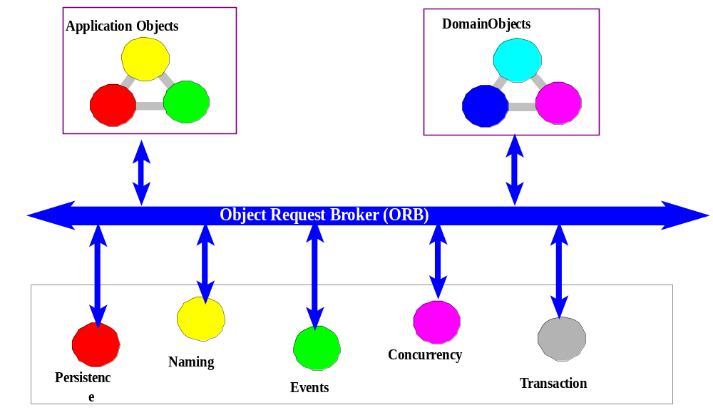
Object Request Brokers (ORBs)
ORBs implement a communication channel through which applications can access object interfaces and request data and services.

Slide 52
Microsoft's ActiveX/DCOM
The Distributed Component Object model, Microsoft's alternative to OMG's CORBA.
DCOM is an Internet and component strategy where ActiveX (formerly known as object linking and embedding, or OLE) plays the role of DCOM object.

Slide 53
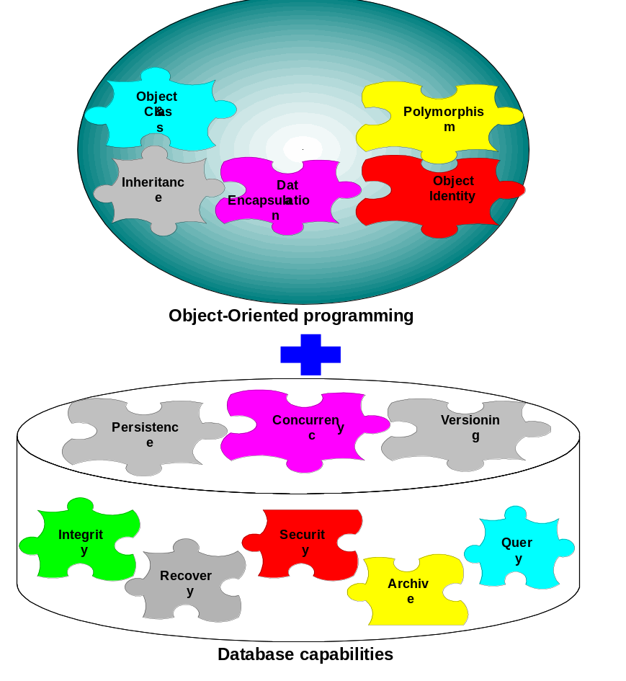
Object-Oriented Database Systems
The object-oriented database management system is a marriage of object-oriented programming and database technology to provide what we now call object-oriented databases.

Slide 54

Object-Oriented Database System Manifesto
Malcolm Atkinson et al. described the necessary characteristics that a system must satisfy to be considered an object-oriented database.
These categories can be broadly divided into object-oriented language properties and database requirements.

Slide 55

Manifesto (Con’t)
First, the rules that make it an object-oriented system are as follows:
  1. The system must support complex objects.
  2. Object identity must be supported.
  3. Objects must be encapsulated.
  4. The system must support types or classes.
  5. The system must support inheritance.
  6. The system must avoid premature binding.
  7. The system must be computationally complete.

Slide 56
Manifesto (Con’t)
  8. The system must be extensible.
Second, these rules make it a DBMS:
  9. It must be persistent, able to remember an object state.
  10. It must be able to manage very large databases.
  11. It must accept concurrent users.
  12. It must be able to recover from hardware and software failures.
  13. Data query must be simple.

Slide 57
Object-Oriented Databases versus Traditional Databases
The objects are an "active" component in an object-oriented database.
Relational database systems do not explicitly provide inheritance of attributes and methods.
Notes:
Application areas where this kind of complexity exists include engineering, manufacturing, simulations, office automation, and large information systems ("No More Fishing for Data" is a real-world example of this).

Slide 58
Object-Oriented Databases versus Traditional Databases (Con’t)
Each object has its own identity, or object-ID (as opposed to the purely value-oriented approach of traditional databases).
Object identity allows objects to be related as well as shared within a distributed computing network.

Slide 59
Object-Relational Systems: The Practical World
In practice, even though many applications increasingly are developed in an object-oriented environment, chances are good that the data those applications need to access live in a very different universe—a relational database.
Notes:
In such an environment, the introduction of object-oriented development creates a fundamental mismatch between the programming model (objects) and the way in which existing data are stored (relational tables).
To resolve the mismatch, a mapping tool between the application objects and the relational data must be established. Creating an object model from an existing relational database layout (schema) often is referred to as reverse engineering. Conversely, creating a relational schema from an existing object model often is referred to as forward engineering. In practice, over the life cycle of an application, forward and reverse engineering need to be combined in an iterative process to maintain the relationship between the object and relational data representations

Slide 60
Object-Relation Mapping
For a tool to be able to define how relational data maps to and from application objects, it must have at least the following mapping capabilities:
Table-class mapping.
Table-multiple classes mapping.
Table-inherited classes mapping.
Tables-inherited classes mapping.
Notes:
In a relational database, the schema is made up of tables, consisting of rows and columns, where each column has a name and a simple data type. In an object model, the counterpart to a table is a class (or classes), which has a set of attributes (properties or data members). Object classes describe behavior with methods.
A tuple (row) of a table contains data for a single entity that correlates to an object (instance of a class) in an object-oriented system. In addition, a stored procedure in a relational database may correlate to a method in an object-oriented architecture. A stored procedure is a module of precompiled SQL code maintained within the database that executes on the server to enforce rules the business has set about the data. Therefore, the mappings essential to object and relational integration are between a table and a class, between columns and attributes, between a row and an object, and between a stored procedure and a method.

Slide 61
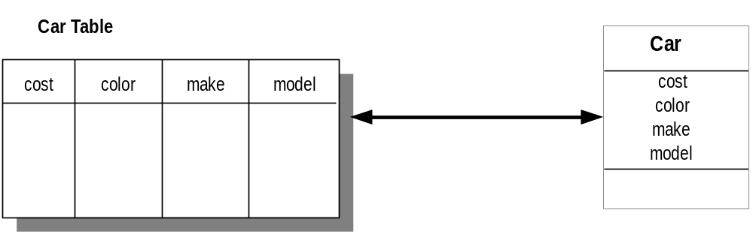
Table-Class Mapping
Each row in the table represents an object instance and each column in the table corresponds to an object attribute.

Slide 62
Table-Multiple Classes Mapping
The custID column provides the discriminant. If the value for custID is null, an Employee instance is created at run time; otherwise, a Customer instance is created.
Employee
Person Table
name
address
name
address
custID
empID
empID
Customer
name
address
custID

Slide 63
Table-Inherited Classes Mapping
Instances of SalariedEmployee can be created for any row in the Person table that has a non null value for the salary column. If salary is null, the row is represented by an HourlyEmployee instance.
Employee
name
ssn
Person Table
address
name
address
ssn
wage
salary
HourlyEmployee
SalariedEmployee
wage
salary

Slide 64
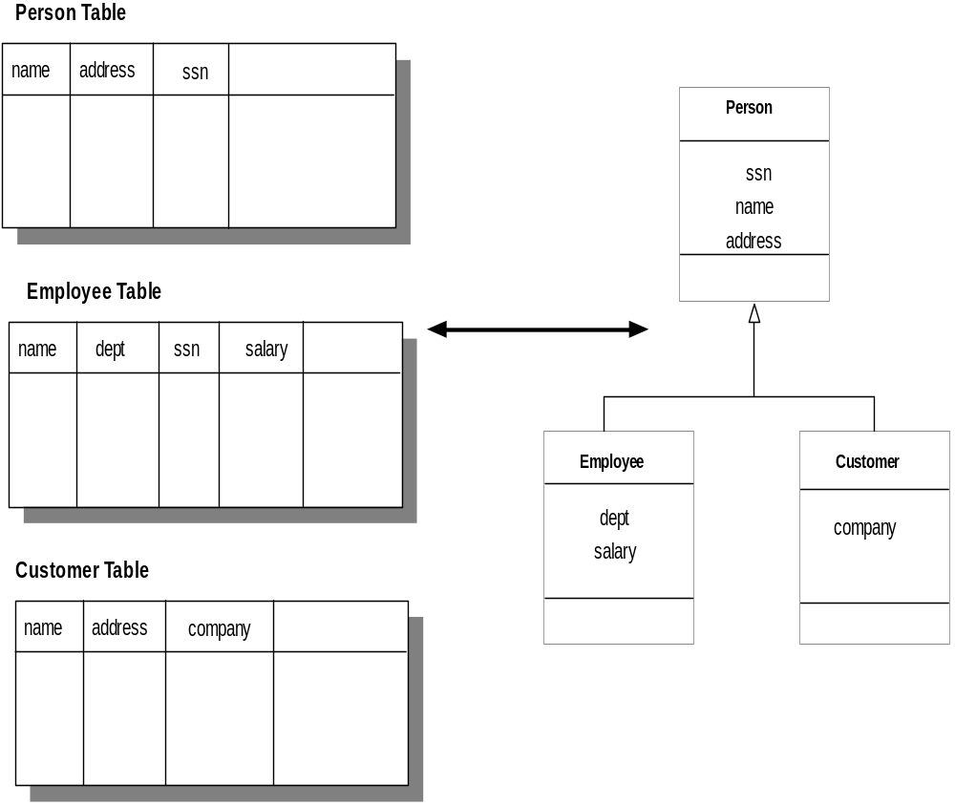
Tables-Inherited Classes Mapping
Instances of Person are mapped directly from the Person table. However, instances of Employee can be created only for the rows in the Employee table (the joins of the Employee and Person tables on the ssn key). The ssn is used both as a primary key on the Person table and as a foreign key on the Person table and a primary key on the Employee table for activating instances of type Employee.

Slide 65
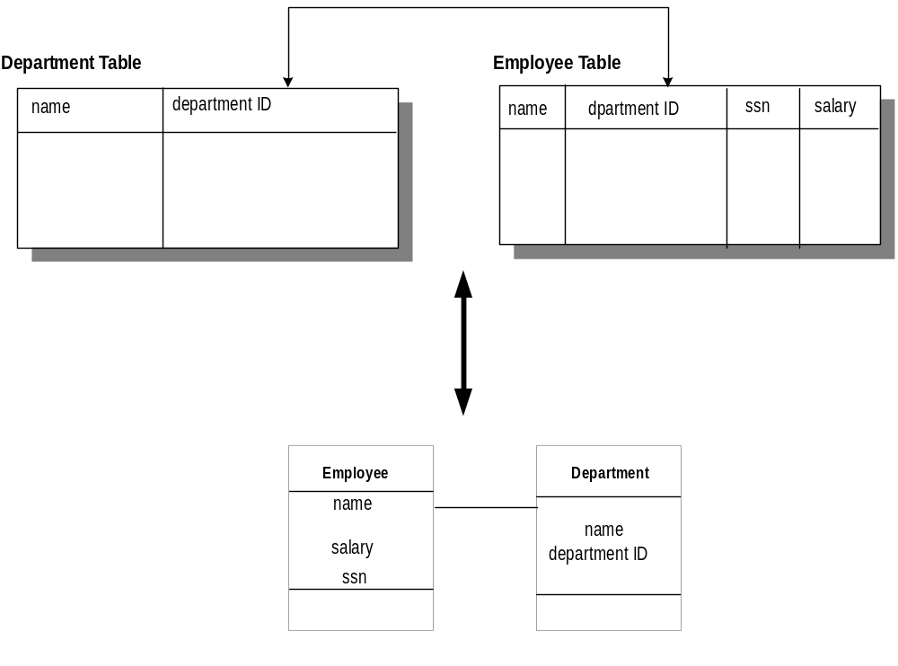
Keys for Instance Navigation
The departmentID property of Employee uses the foreign key in column Employee.departmentID. Each Employee instance has a direct reference of class Department (association) to the department object to which it belongs.
Notes:
In mapping columns to properties, the simplest approach is to translate a column's value into the corresponding class property value. There are two interpretations of this mapping: Either the column is a data value or it defines a navigable relationship between instances (i.e., a foreign key). The mapping also should specify how to convert each data value into a property value on an instance.
In addition to simple data conversion, mapping of column values defines the interpretation of relational foreign keys. The mapping describes both how the foreign key can be used to navigate among classes and instances in the mapped object model and how referential integrity is maintained. A foreign key defines a relationship between tables in a relational database. In an object model, this association is where objects can have references to other objects that enable instance-to-instance navigation.
In this slide, the departmentID property of Employee uses the foreign key in column Employee.departmentID. Each Employee instance has a direct reference of class Department (association) to the department object to which it belongs.
A popular mechanism in relational databases is the use of stored procedures. As mentioned earlier, stored procedures are modules of precompiled SQL code stored in the database that execute on the server to enforce rules the business has set about the data. Mapping should support the use of stored procedures by allowing mapping of existing stored procedures to object methods.

Slide 66
Multidatabase System
A different approach for integrating object-oriented applications with relational data environments is multidatabase systems, or heterogeneous database systems, which facilitate the integration of heterogeneous databases and other information sources.

Slide 67
Federated Multidatabase Systems
Federated multidatabase systems provide a solution to the problem of interoperating heterogeneous data systems, provide uniform access to data stored in multiple databases that involve several different data models.

Slide 68
MDBS (Con’t)
OODBMS
DBMS
DBMS
OODBMS
Local Databases
A multidatabase system (MDBS) is a database system that resides on top of, say existing relational and object databases and file systems (called local database systems) and presents a single database illusion to its users.
Virtual database
Application

Slide 69
Characteristics of MDBS
Automatic generation of a unified global database schema from local databases.
Provision of cross-database functionality (global queries, updates, and transactions) by using unified schemata.
Integration of a heterogeneous database system with multiple databases.

Slide 70
Characteristics of MDBS (Con’t)
Integration of data types other than relational data through the use of such tools as driver generators.
Provision of a uniform but diverse set of interfaces (e.g., a SQL-style interface, browsing tools, and C++) to access and manipulate data stored in local databases.

Slide 71
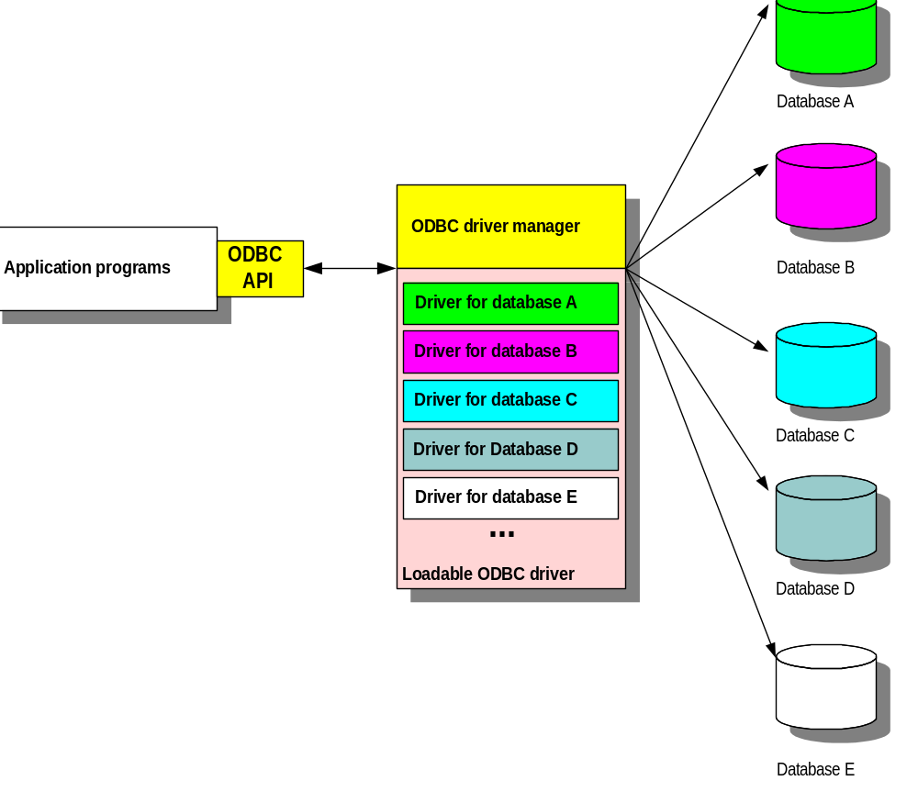
Open Database Connectivity
Open database connectivity (ODBC), provides a mechanism for creating a virtual DBMS.

Slide 72
Designing Access Layer Classes
The main idea behind creating an access layer is to create a set of classes that know how to communicate with data source, whether it be a file, relational database, mainframe, Internet, DCOM, or via ORB.
The access classes must be able to translate any data-related requests from the business layer into the appropriate protocol for data access.

Slide 73
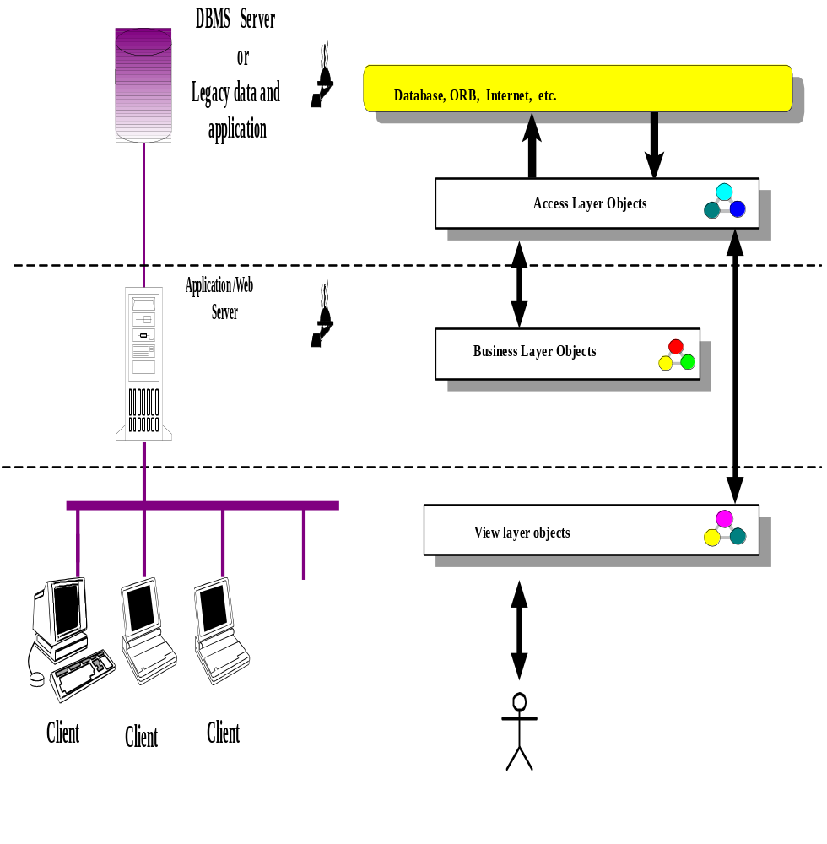
Access Layer Classes (Con’t)
The business layer objects and view layer objects should not directly access the database. Instead, they should consult with the access layer for all external system connectivity.
Notes:
Ask students, Why?

Slide 74
Benefits of Access Layer Classes
Access layer classes provide easy migration to emerging distributed object technology, such as CORBA and DCOM.
These classes should be able to address the (relatively) modest needs of two-tier client/server architectures as well as the difficult demands of fine-grained, peer-to-peer distributed object architectures.

Slide 75
Process
The access layer design process consists of these following activities:
1. If methods will be stored in a program then
For every business class identified, determine if the class has persistent data.
else
For every business class identified, mirror the business class package.
2. Define relationships. The same rule as applies among business class objects also applies among access classes.
Notes:
1. For every business class identified, mirror the business class package. For every business class that has been identified and created, create one access class in the access layer package. For example, if there are three business classes (Class1, Class2, and Class3), create three access layer classes (Class1DB, Class2DB, and Class3DB).
2. Define relationships. The same rule as applies among business class objects also applies among access classes (see Chapter 8).
3. Simplify classes and relationships. The main goal here is to eliminate redundant or unnecessary classes or structures. In most cases, you can combine simple access classes and simplify the super- and subclass structures.
3.1. Redundant classes. If you have more that one class that provides similar services (e.g., similar Translate request and Translate results), simply select one and eliminate the other(s).
3.2. Method classes. Revisit the classes that consist of only one or two methods to see if they can be eliminated or combined with existing classes. If you can find no class from the access layer package, select its associated class from the business package and add the method(s) as a private method(s) to it. In this case, we have created an access method.
4. Iterate and refine.

Slide 76
Process (Con’t)
3. Simplify classes and relationships. The main goal here is to eliminate redundant or unnecessary classes or structures.
  3.1. Redundant classes. If you have more than one class that provides similar services, simply select one and eliminate the other(s).
  3.2. Method classes. Revisit the classes that consist of only one or two methods to see if they can be eliminated or combined with existing classes.
4. Iterate and refine.

Slide 77
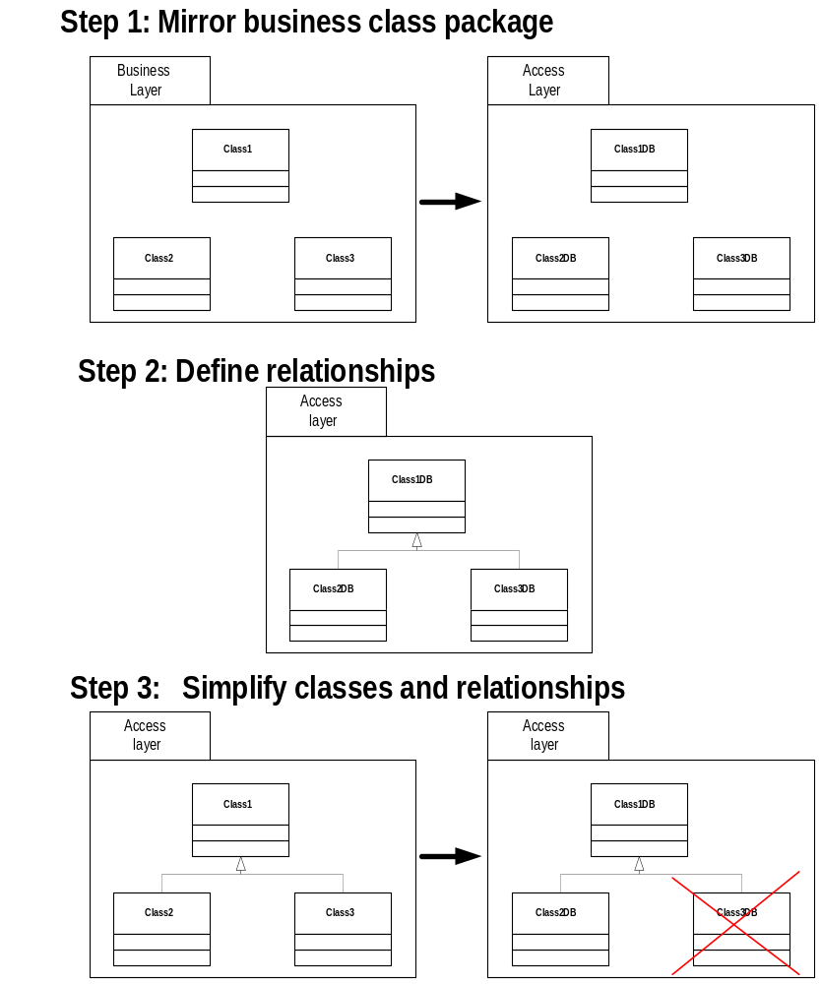
Process of Creating Access Layer Classes

Slide 78
Access Layer Classes (Con’t)
The relation between a business class and its associated access class.
Business class
Class1
Access class
for Class1
Class1DB

Slide 79

Summary
The fundamental purpose of a DBMS is to provide a reliable persistent data storage facility and the mechanisms for efficient, convenient data access and retrieval.
Many modern databases are distributed databases.

Slide 80
Summary (Con’t)
Client/server computing is the logical extension of modular programming.
Distributed computing is a second client/server revolution, a transition to an immensely expanded client/server era.
The object-oriented database technology is a marriage of object-oriented programming and database technology.

Slide 81
Summary (Con’t)
In practice, even though many applications increasingly are developed using object-oriented programming technology, the data those applications need to access live in a relational database.

Slide 82
Summary (Con’t)
The main process in relational-object integration is defining the relationships between the table structures (represented as schemata) in the relational database with classes (representing classes) in the object model.

Slide 83
Summary (Con’t)
A different approach for integrating object-oriented applications with relational data environments involves multidatabase systems, or heterogeneous database systems, which facilitate the integration of heterogeneous databases and other information sources.

Slide 84
Summary (Con’t)
The main idea behind an access layer is to create a set of classes that know how to reach the data source.
Access layer classes provide easy migration to emerging distributed object technology, such as CORBA and DCOM.

